Slide 1
Integrated Project-I
SPOT LIGHT
Submitted By
Name : Aarshiya, Jahnavi, Kush, Kartik
University ID : 2111981342, 2111981333, 2111981293, 2111981328
Supervisor
Under the Guidance Of
Name : Dr. Alok Misra
Designation : Professor
Department of Computer Science & Engineering
Chitkara University, Himachal Pradesh

Slide 2
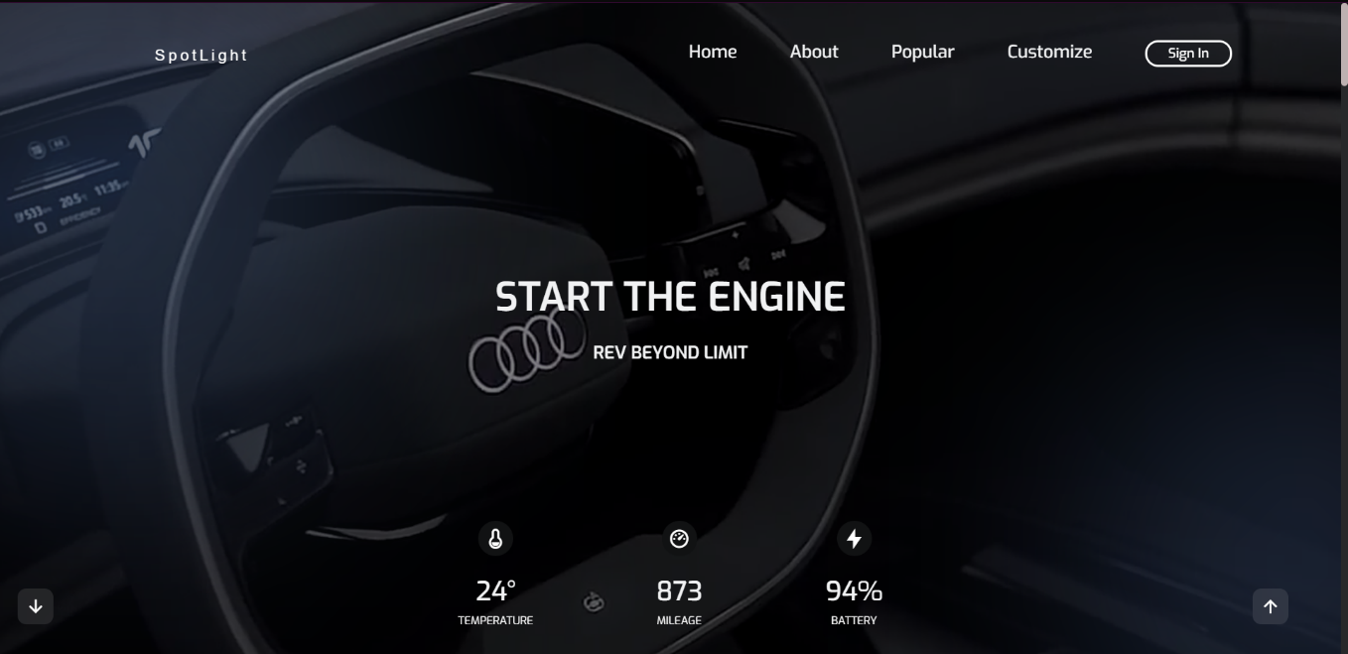
ABOUT US
The website is for a car dealership that showcases different cars, primarily German and electric models.

Slide 3
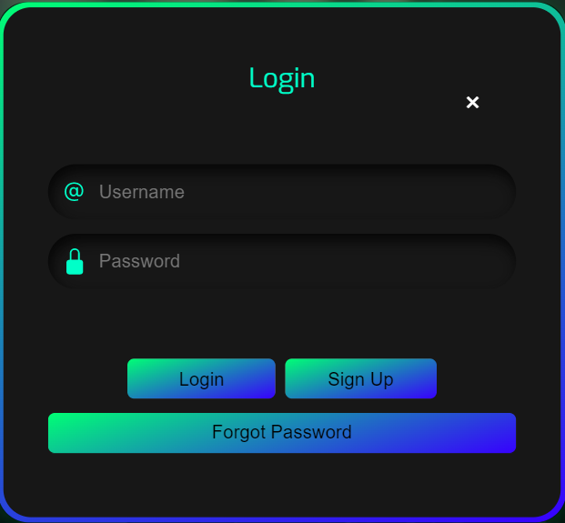
LOGIN PAGE
The login page allows user to access website by entering their username and password or by authenticating with social network login.

Slide 4
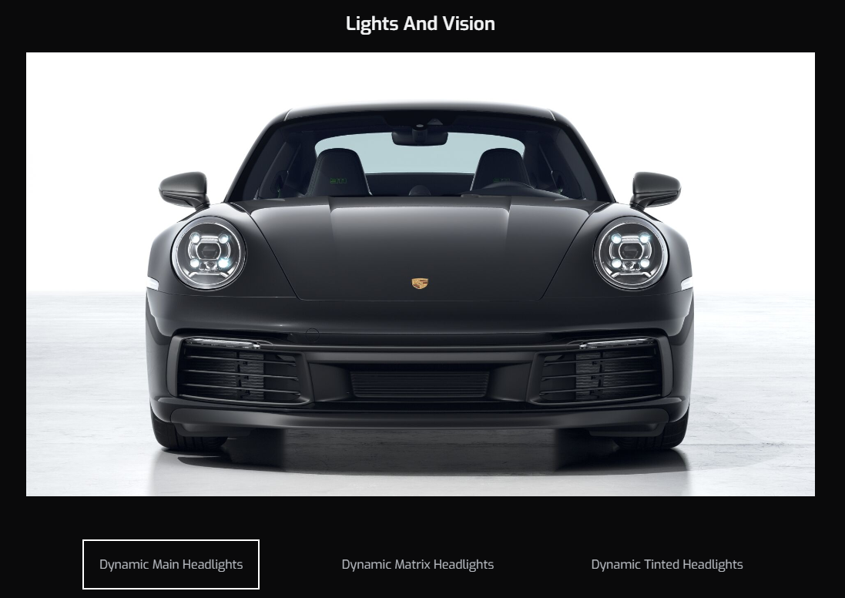
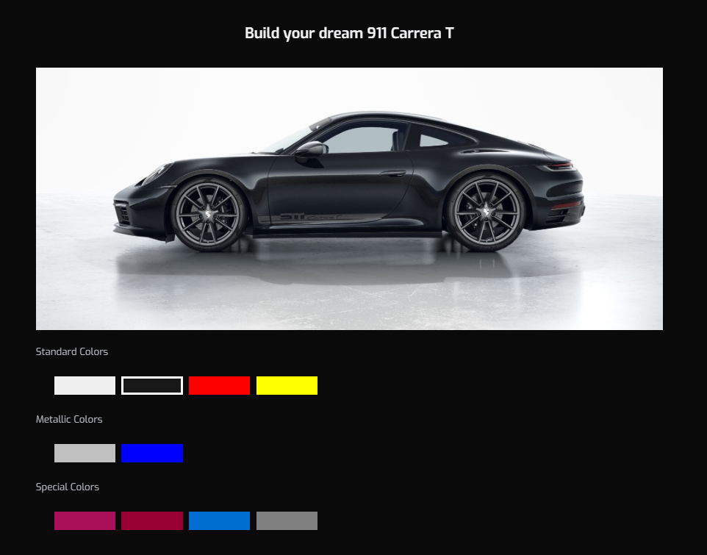
headlights, and taillights of the cars and shows their 3D view.
SALIENT FEATURES
The website allows users to customize the colour, rims,

Slide 5
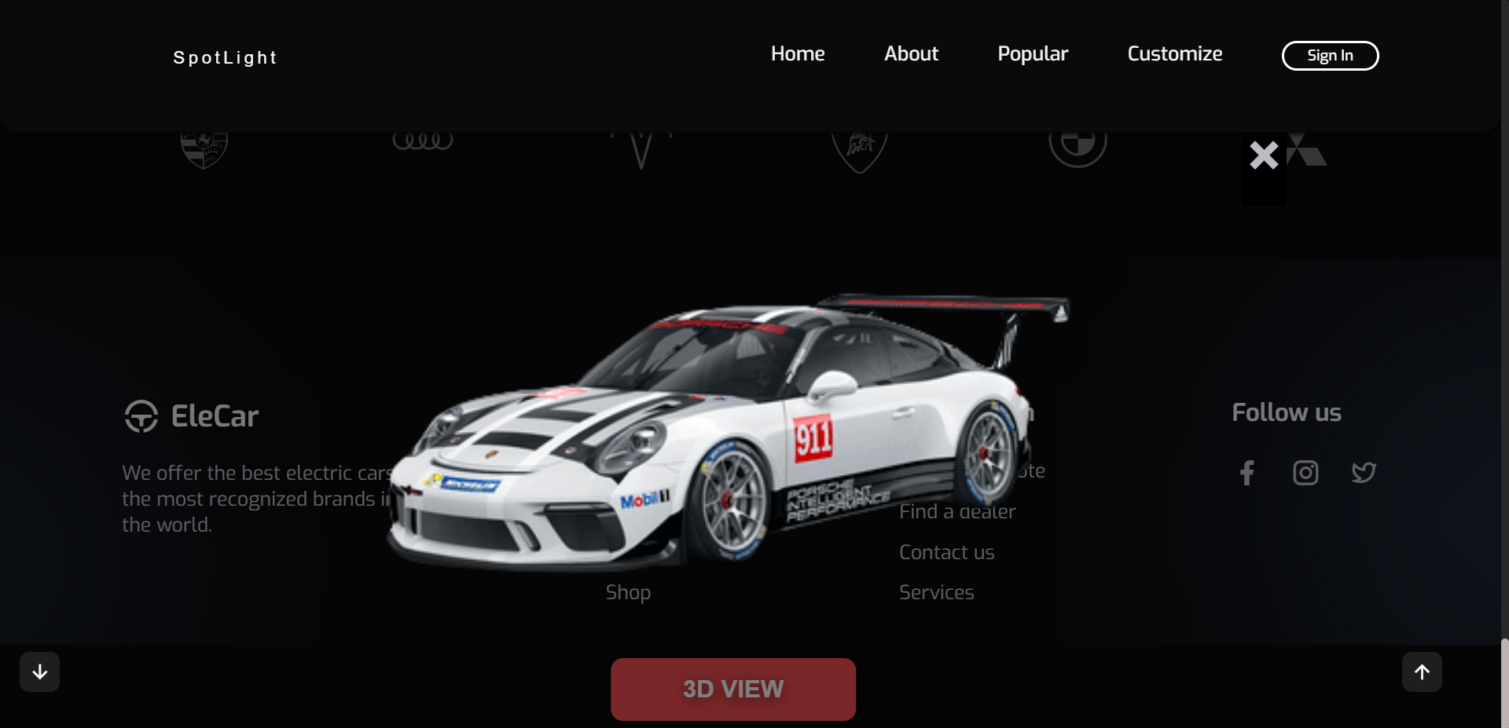
3D VIEW
Website shows a 3D view of cars. This picture shows a 360-degree rotatable 3D model available on the website. You can freely rotate a car in any direction.

Slide 6
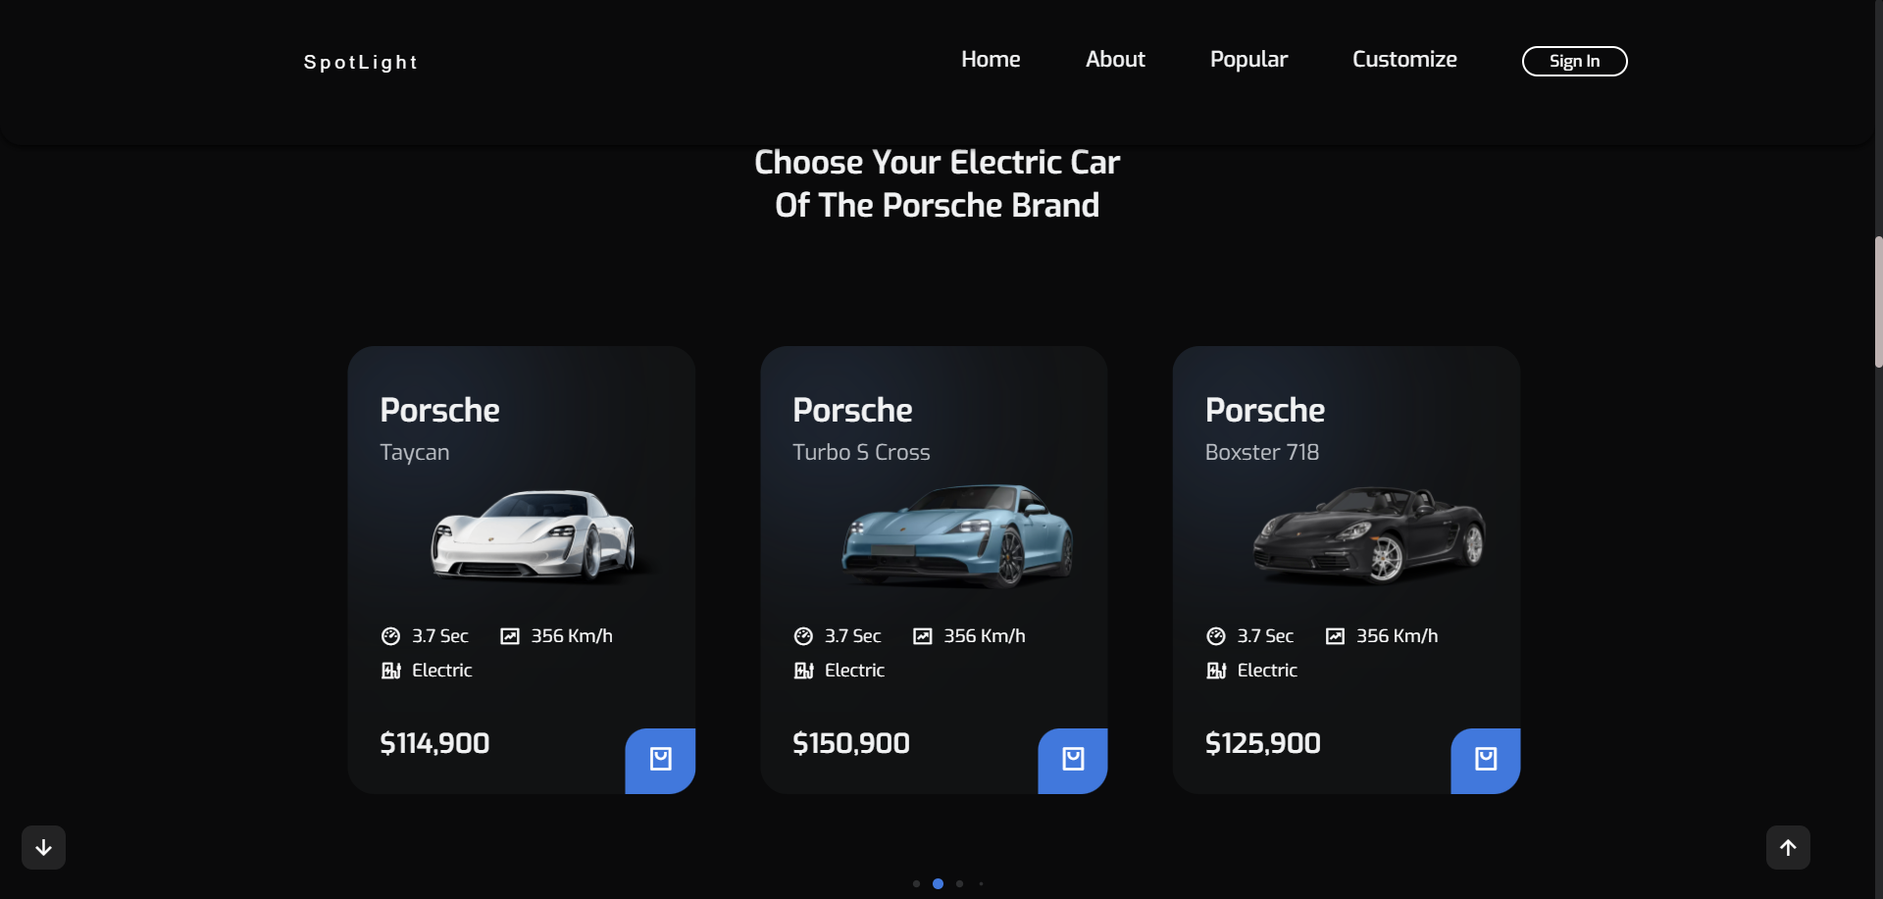
SWIPER BUNDLE FOR PORSCHE
Users can swipe through different featured cars and search for specific car brands.

Slide 7
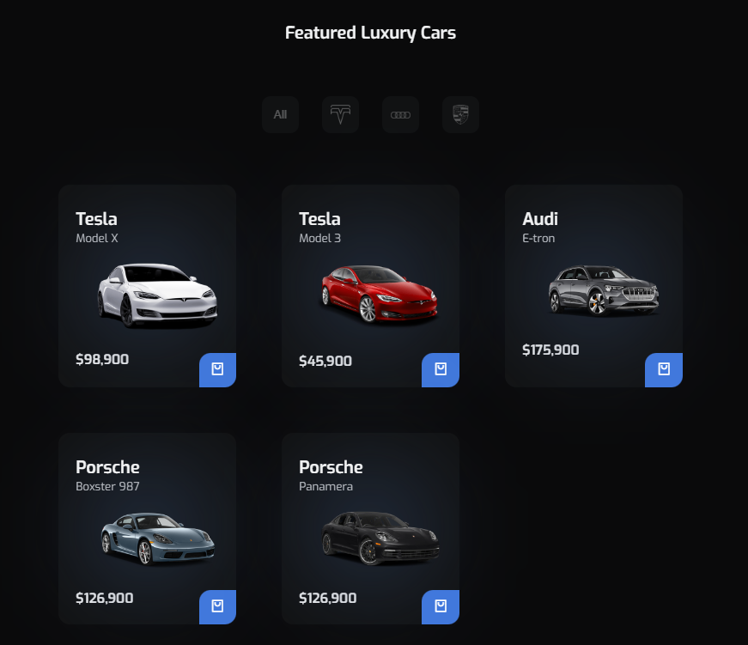
POPULAR CARS FILTER
Customers can browse inventory and filter search results based on their preferences, such as make, model, year, price range, and location. Featured companies include Audi, Tesla, Porsche.

Slide 8
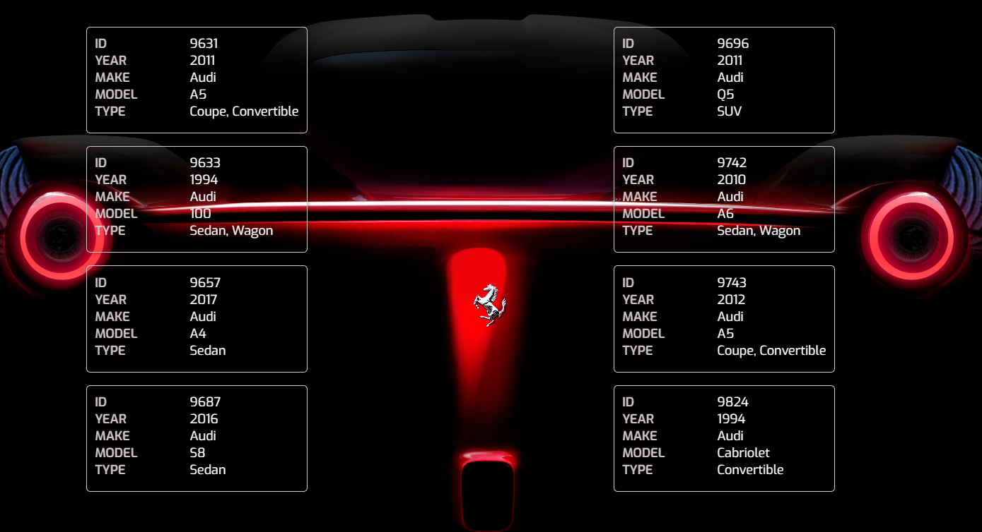
EXTRACT CAR MAKE DATA
User can see any Car’s ID, make year, model and type by just typing in the manufacturer’ name. This is done using a car finder API.

Slide 9
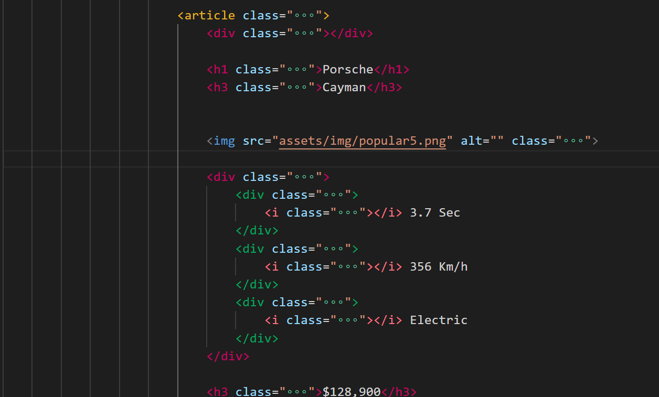
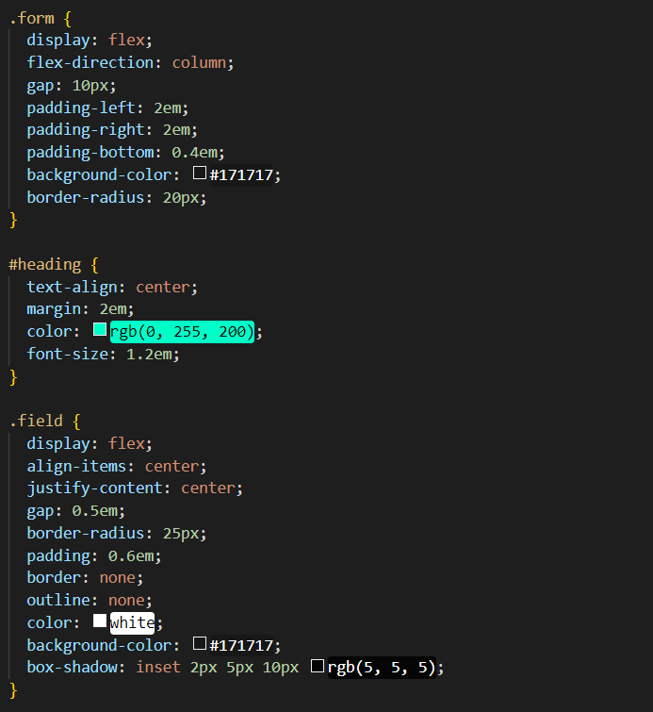
LANGUAGES USED
HTML
CSS
JS
HTML - CSS - JAVASCRIPT

Slide 10
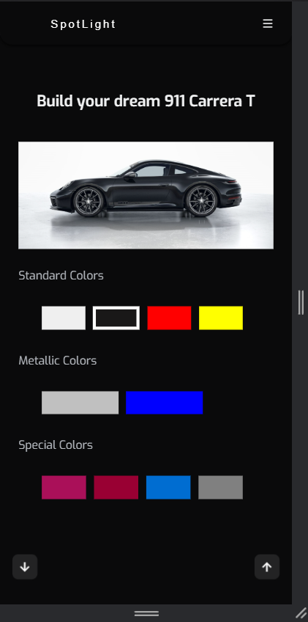
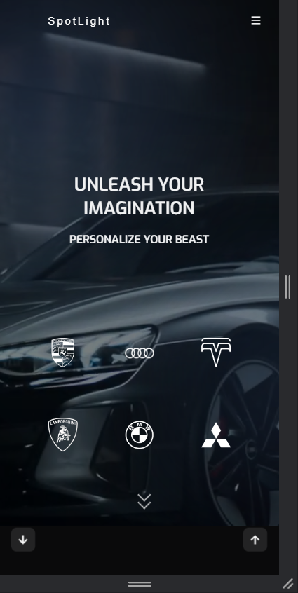
RESPONSIVE
Spotlight is a fully responsive website.
Showcasing all the features irrespective of the device that is used to access the services.

Slide 11

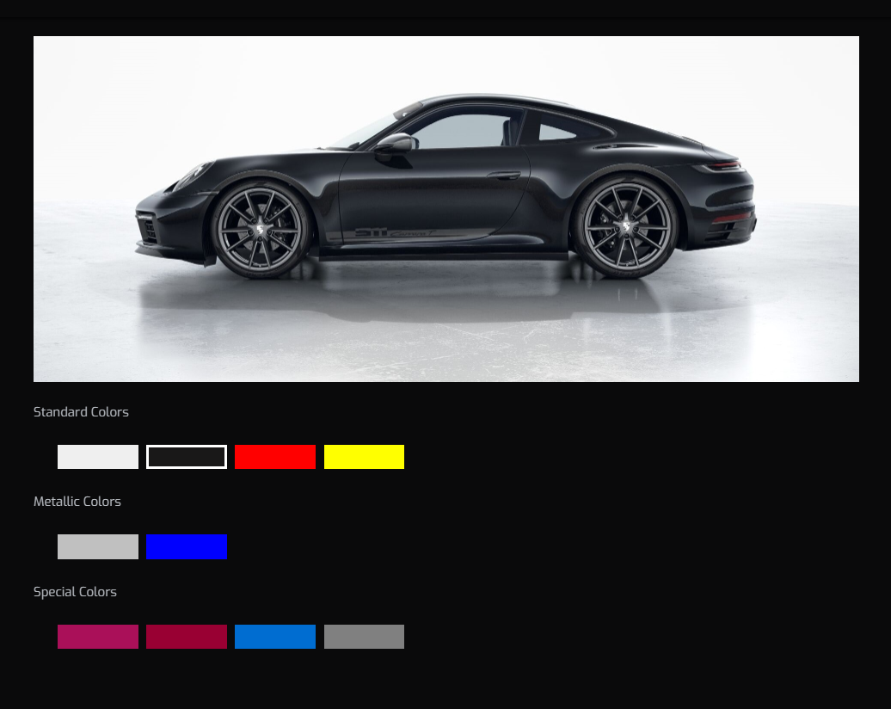
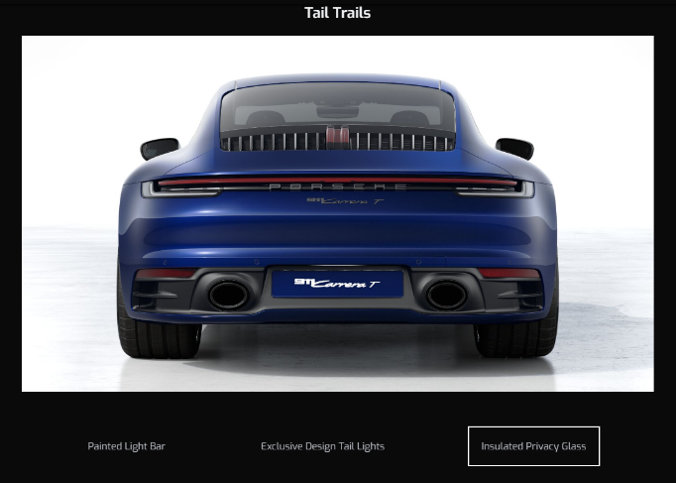
CUSTOMIZATION
Using Spotlight, personalize your ride from the comfort of your own home with our customization tools. Choose from a variety of options to make your dream car a reality.

Slide 12
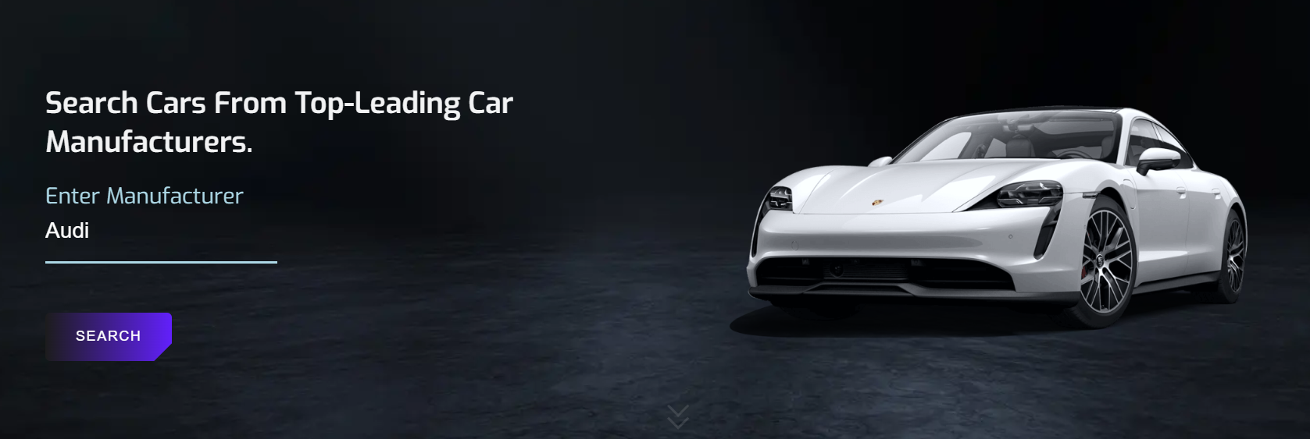
INTERACTIVE VISUALS
Spotlight contains various videos of featured car brands from all over the world [Audi, Ferrari, Porsche etc.], This UI/UX features helps the users to explore every detail with ease.

Slide 13
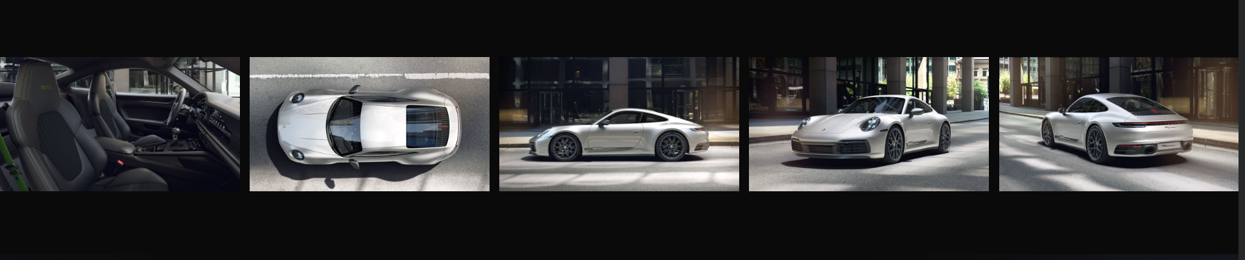
FUTURE SCOPE
The website can expand its scope by incorporating more advanced technologies such as virtual reality showrooms
Additionally, the website can explore partnerships with other industries such as insurance and financing to provide customers with a complete car-buying experience.

Slide 14
We appreciate your consideration and time for our website
THANK YOU

